Slide 1
NLP 220 Data Science and Machine Learning Fundamentals Lecture 14
Jalal Mahmud
jumahmud@ucsc.edu

Slide 2
Data Wrangling with Pandas
https://towardsdatascience.com/data-wrangling-with-pandas-5b0be151df4e

Slide 3
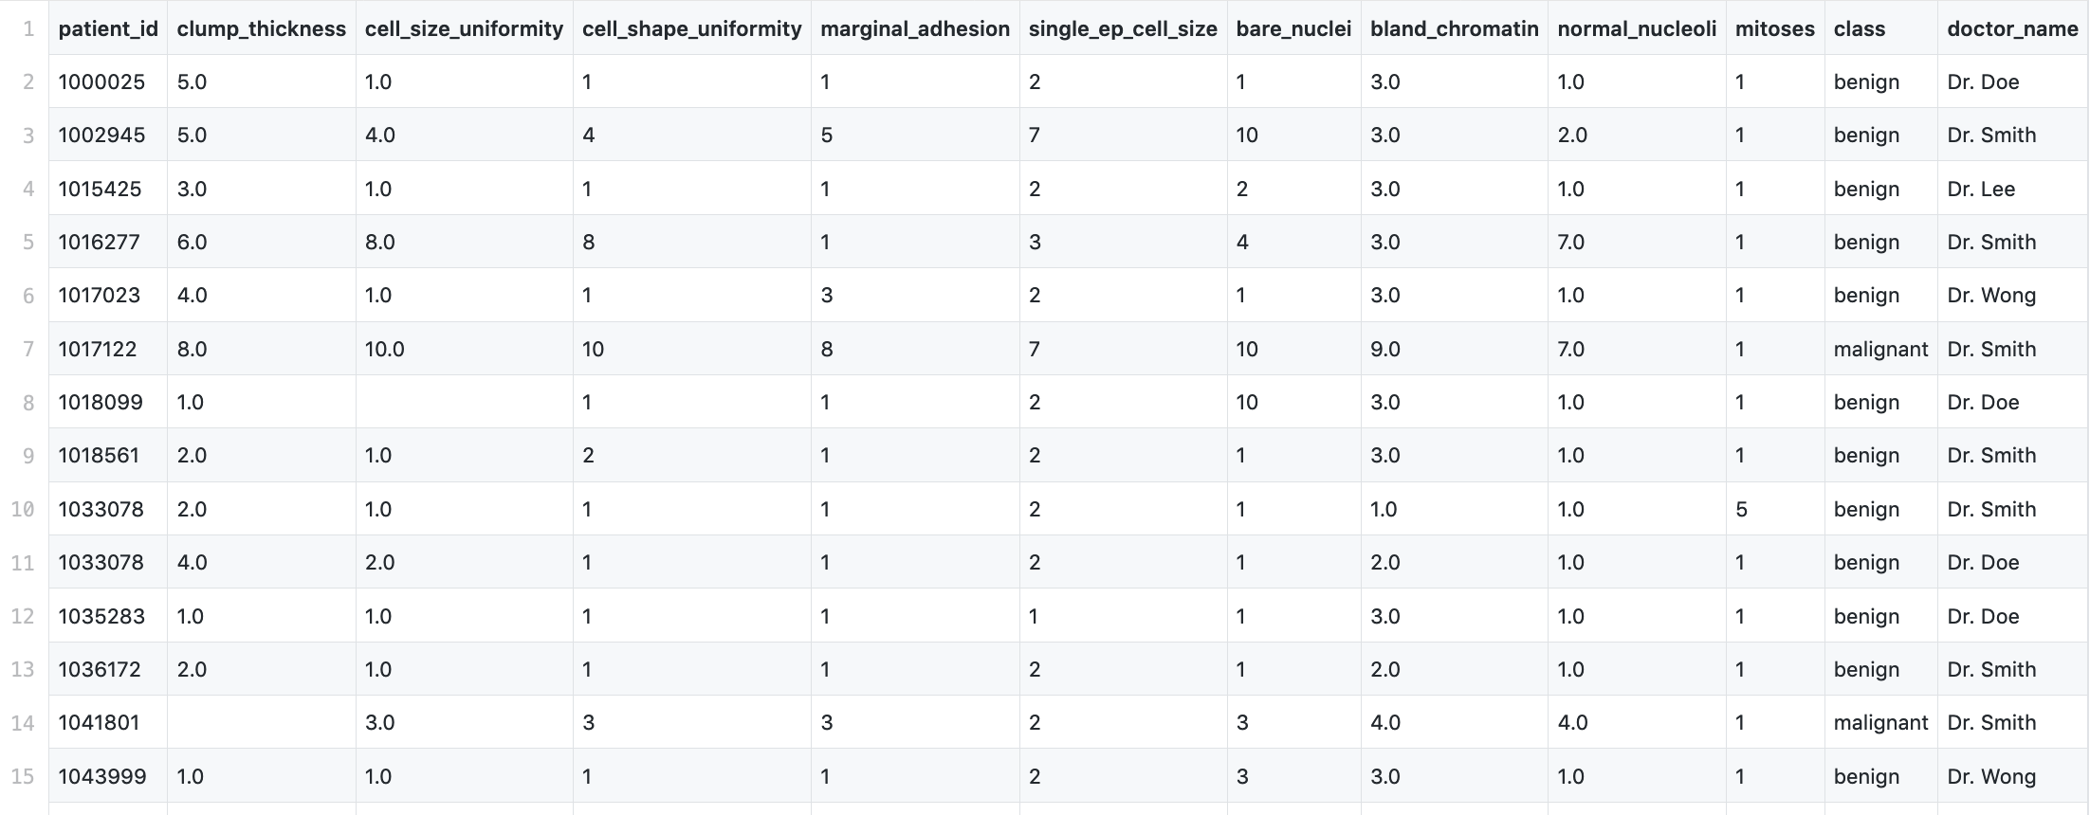
Data Wrangling with Pandas
Data exploration
https://github.com/moeraza/pandas_data_wrangling/blob/master/data/breast_cancer_data.csv
https://towardsdatascience.com/data-wrangling-with-pandas-5b0be151df4e

Slide 4
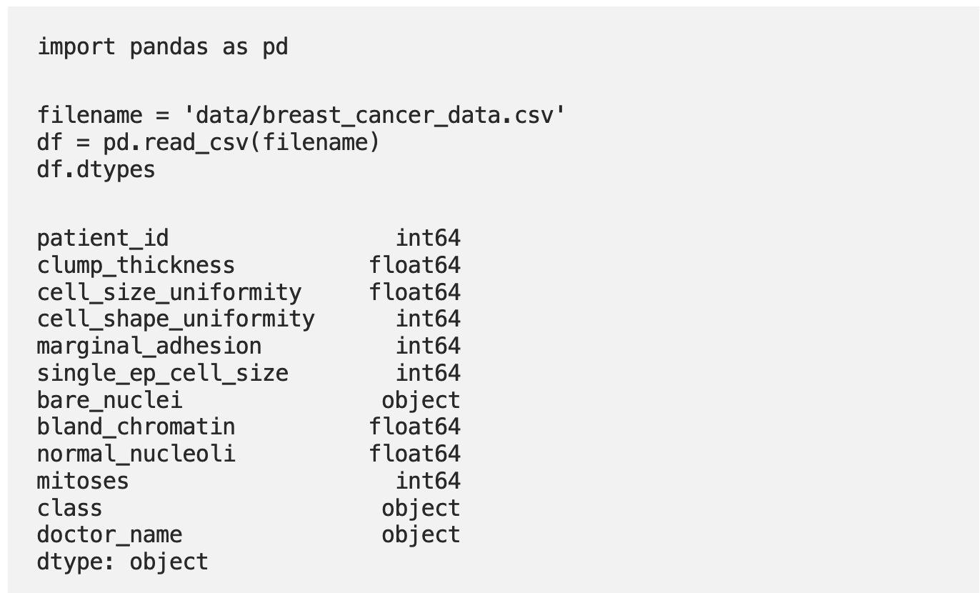
Data Wrangling with Pandas
Data exploration
https://towardsdatascience.com/data-wrangling-with-pandas-5b0be151df4e

Slide 5
Data Wrangling with Pandas
Data exploration
We can assume that patient_id is a unique identifier,
Class is going to tell us whether the tumor is malignant (cancerous) or benign (not cancerous).
The remaining columns are numeric medical descriptions of the tumor, except for the doctor_name which is a categorical feature.
https://towardsdatascience.com/data-wrangling-with-pandas-5b0be151df4e

Slide 6
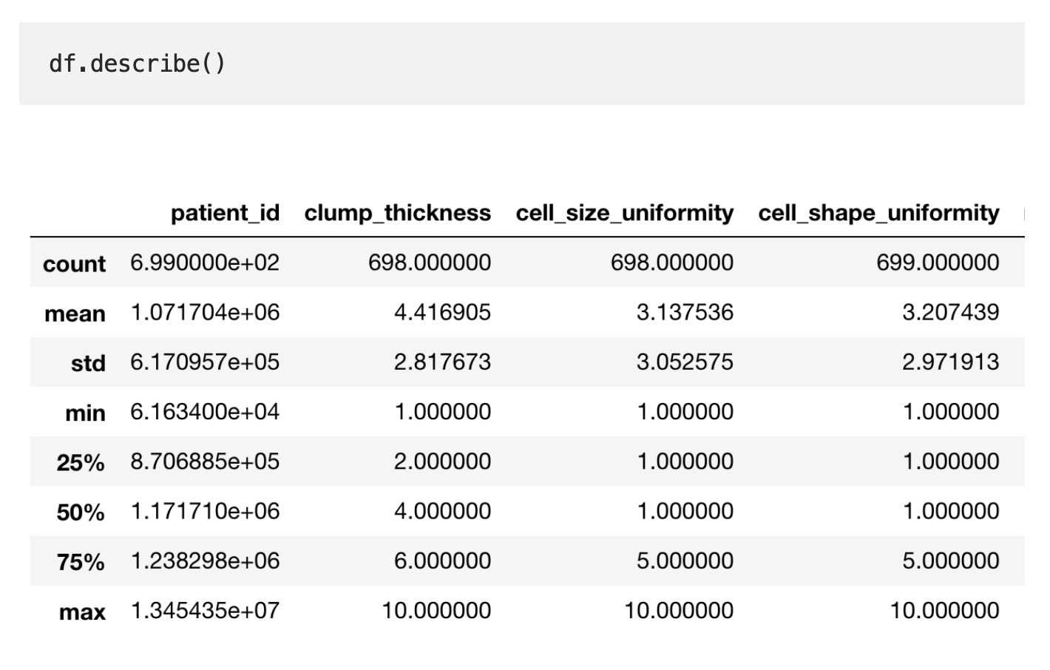
Data Wrangling with Pandas

Slide 7
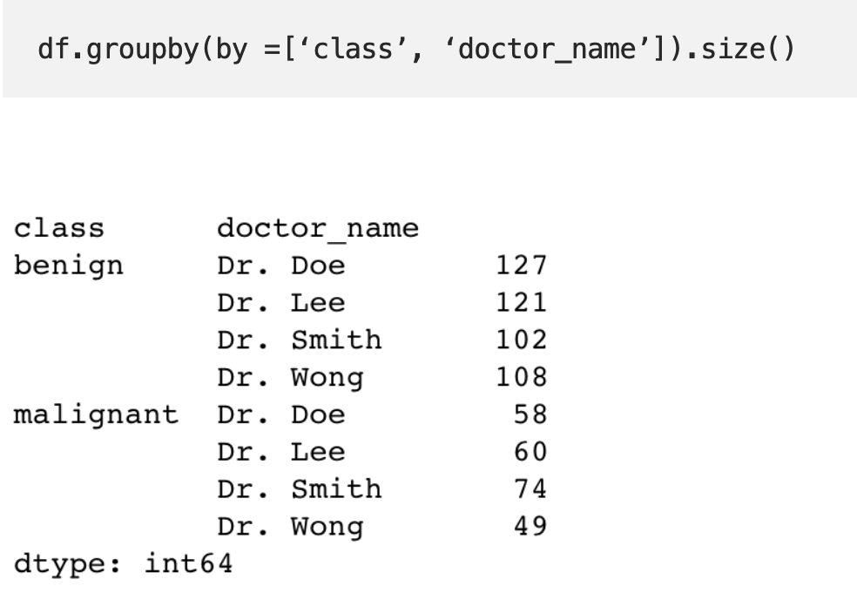
Data Wrangling with Pandas
For categorical data we can hand this by grouping together values:

Slide 8
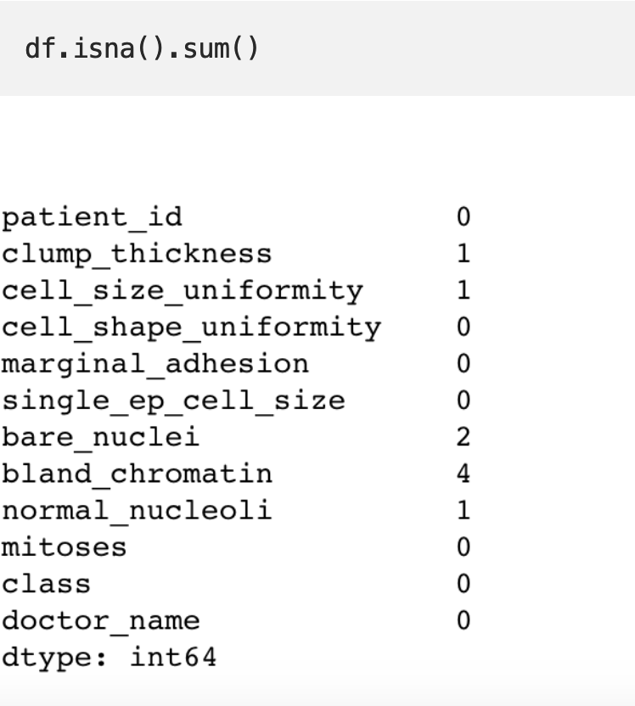
Dealing with Missing Values
With every dataset it is vital to evaluate the missing values. How many are there? Is it an error? Are there too many missing values?

Slide 9
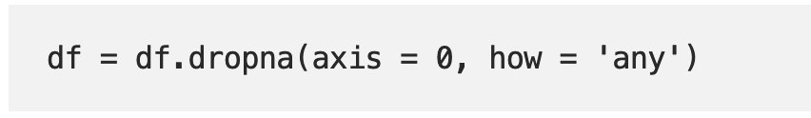
Dealing with Missing Values
Now that we have identified our missing values, we have a few options.
We can fill them in with a certain value (zero, mean/max/median by column, string) or drop them by row.
Since there are few missing values, we can drop the rows to avoid skewing the data

Slide 10
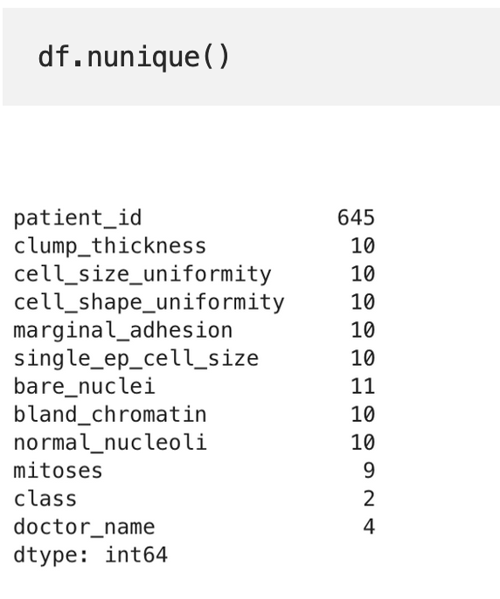
Inspecting Duplicates
We see here that although there are 699 rows, there are only 645 unique patient_id’s. This could mean that some patient appear more than once in the dataset.

Slide 11
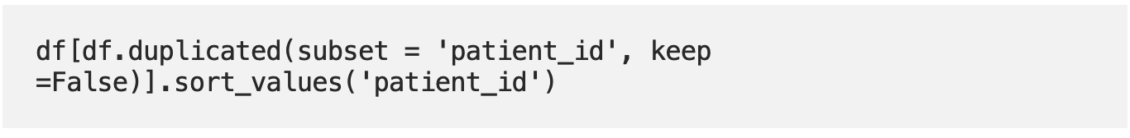
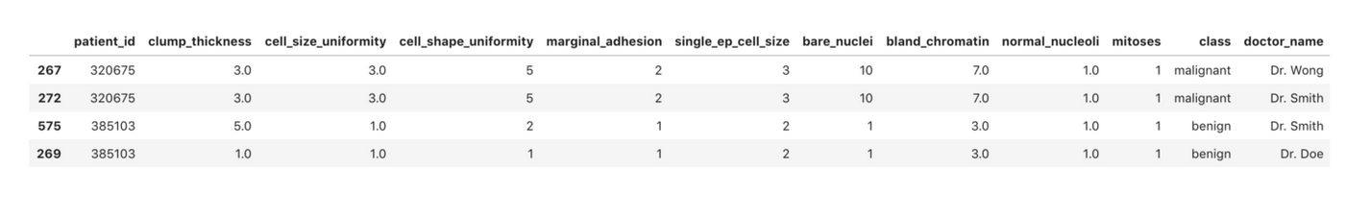
Inspecting Duplicates

Slide 12
Filtering Data

Slide 13
Row-wise Operations

Slide 14
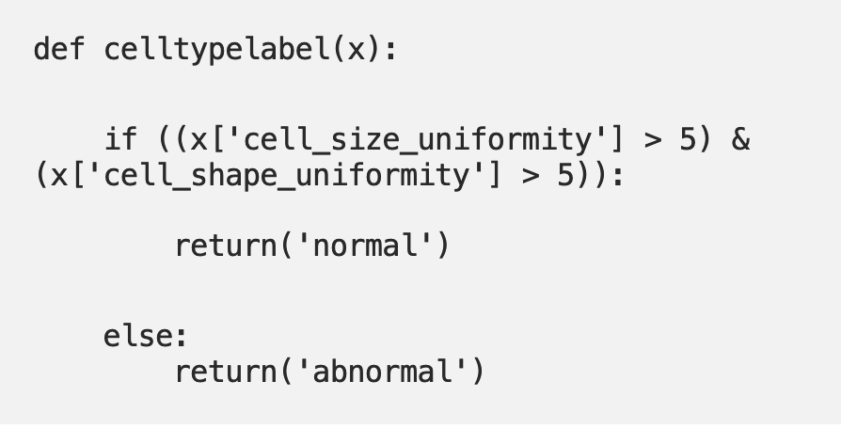
Row-wise Operations
Another key component in data wrangling is having the ability to conduct row-wise or column wise operations.
Examples of this are; rename elements within a column based on its value and create a new column that yields a specific value based on multiple attributes within the row.

Slide 15
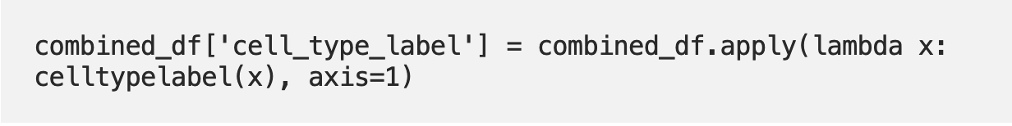
Row-wise Operations
Then we use the pandas apply function to run the celltypelabel(x) function on the data-frame.

Slide 16
Another Example of Data Cleaning using Python and Pandas
https://medium.com/better-programming/data-cleaning-with-python-pandas-an-introduction-1cfd5cde6884

Slide 17
Data Cleaning using Python and Pandas
https://data.cityofnewyork.us/Housing-Development/DOB-Violations/3h2n-5cm9
endpoint = 'https://data.cityofnewyork.us/resource/3h2n-5cm9.json?$where=starts_with(issue_date,"2019")&$limit=10000'
headers={'X-App-Token': NYC_OPEN_DATA_API_KEY}
result = requests.get(endpoint, headers=headers)
df = pd.DataFrame(result.json())

Slide 18
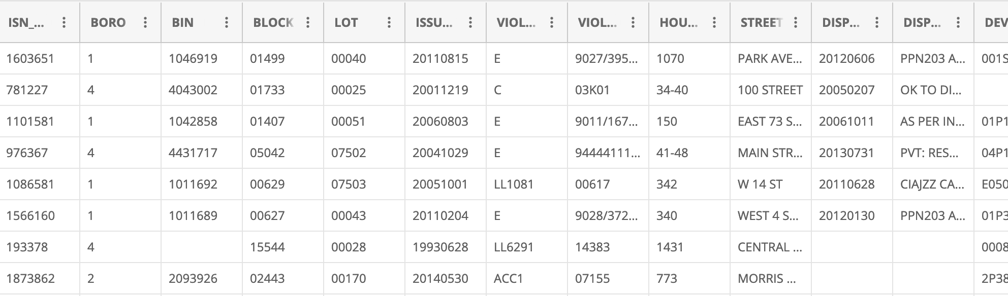
Data Cleaning using Python and Pandas
https://data.cityofnewyork.us/Housing-Development/DOB-Violations/3h2n-5cm9

Slide 19
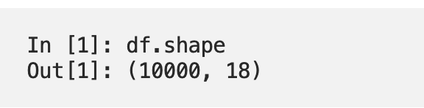
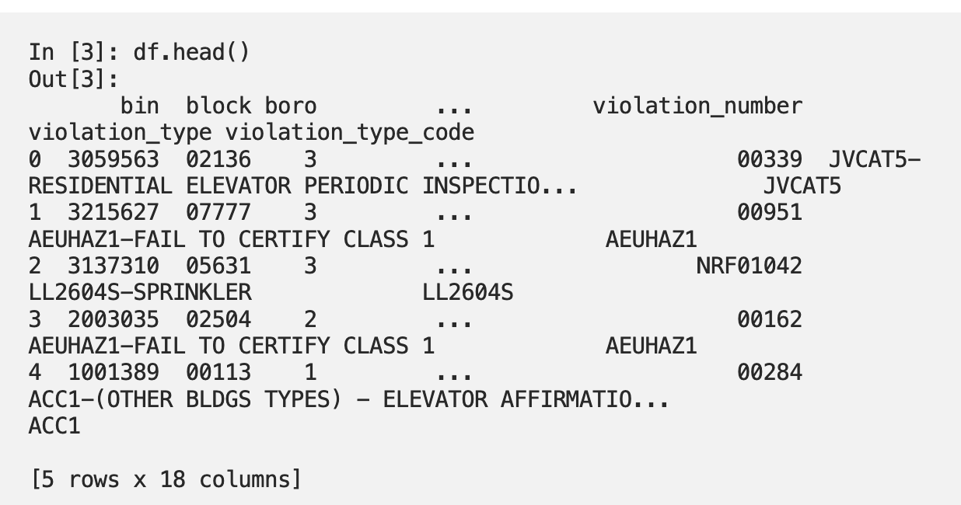
Data Cleaning using Python and Pandas

Slide 20
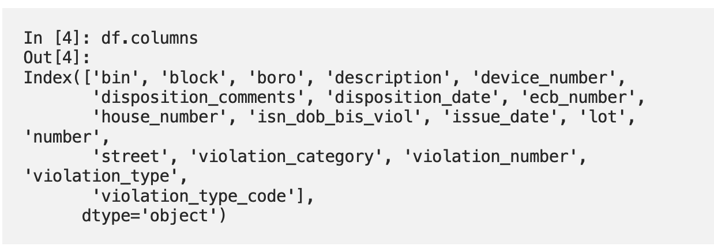
Data Cleaning using Python and Pandas

Slide 21
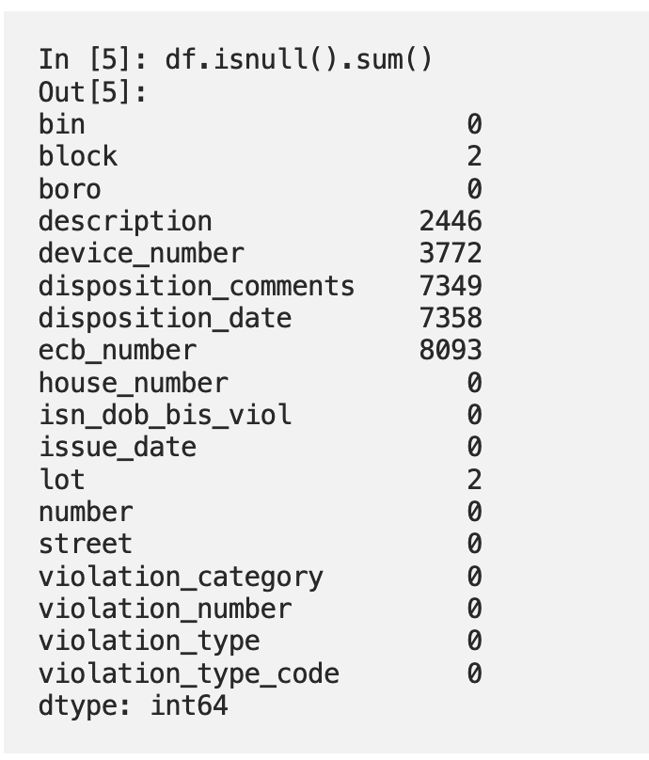
Missing/Null Values

Slide 22
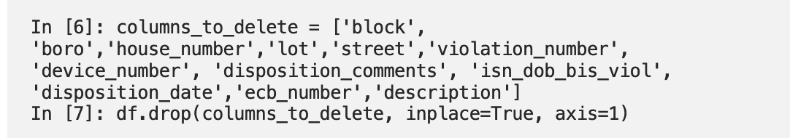
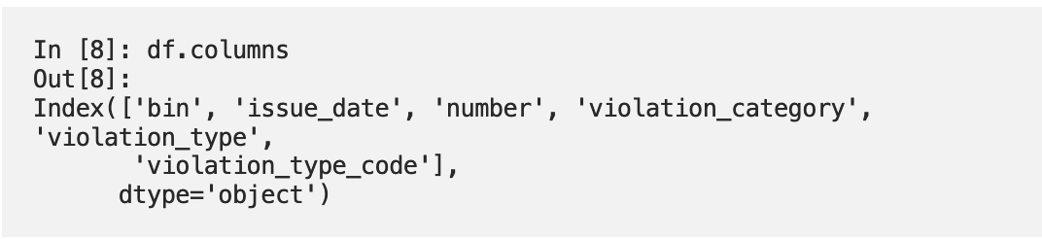
Dropping Irrelevant Columns
Make a list of the columns you want to delete and then pass it to df.drop().
In pandas, axis 0 represents rows and axis 1 represents columns,
so here axis=1 means you are deleting columns.

Slide 23
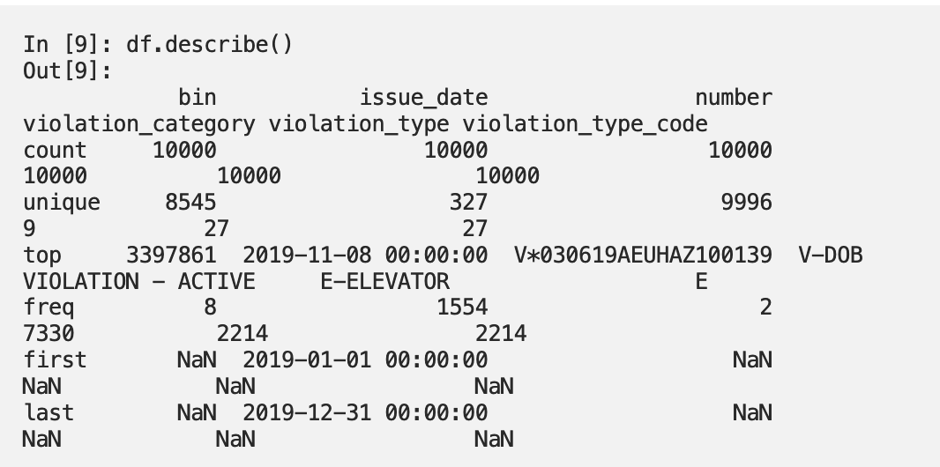
Descriptive Statistics

Slide 24
Data Quality
Datatypes
Constraints
Uniformity
Accuracy
Data consistency
Duplicates

Slide 25
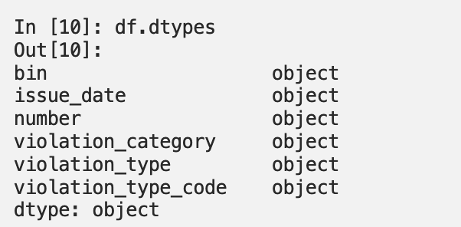
Data Types
It’s important that the data values in each column are the correct data type that you are expecting them to be.
For example, if the data should be in numeric format but you find string data in the column.

Slide 26
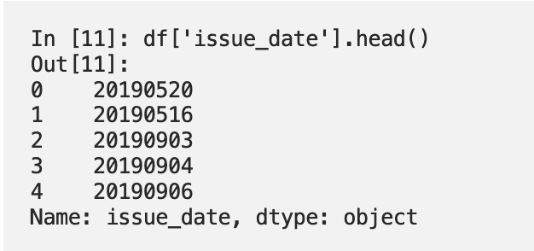
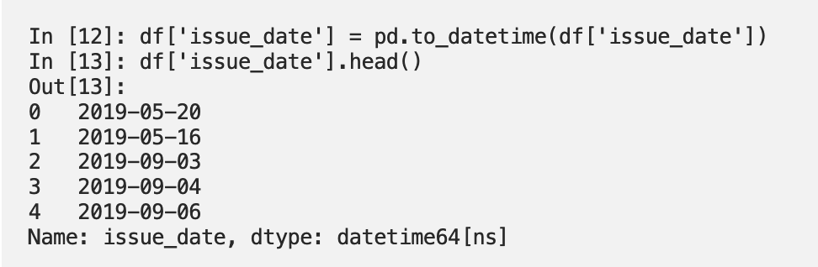
Data Types
The dates are strings in YYYYMMDD format.
We want to convert it to a Python datetime, and pandas has an easy way of doing that with the to_datetime() method

Slide 27
Data Constraints
Make sure any constraints on the data are respected.
There are many types of constraints that you might need to follow with a given dataset.
When cleaning it, you will want to make sure that you test any of them that are relevant.
Date ranges
Number ranges — Minimum or maximum values for a column.
Non-null constraints — If a value should not be null but is.

Slide 28
Data Constraints
Unique constraints — Two or more column values must be unique together in the data.
Foreign key constraints
Patterns — If the data should be in the format of an email address or phone number, it can be validated with regular expressions for these patterns.
If you’re working with geographic data like longitude and latitude, you could set boundaries for acceptable latitude and longitude coordinates if you know where your data points should be located, and if points fall far outside of that boundary you know you need to examine it further.

Slide 29
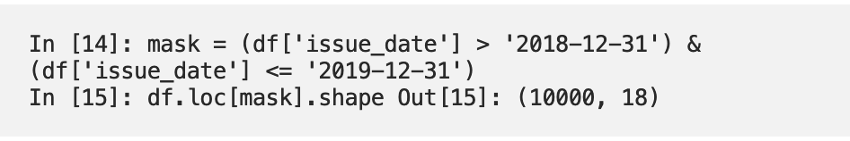
Data Constraints
The building violations data should all have dates in 2019.
We have converted the column to the Python datetime format, so we could test that the date range is correct by creating a boolean mask
An array of True or False values for each item in the column — and then making sure that all rows that return True add up to the number of rows I expect to have.

Slide 30
Uniformity & Data Accuracy
Values in a dataset should be the correct datatype, and they should also be uniform in units as well.
If some samples in a column are in miles-per-hour units while others are in kilometers-per-hour, then any analysis will be based on partially incorrect data.
Checking for data accuracy can be closely tied to the constraints.
A user might enter a U.S. phone number as “000–000–0000”, which is the correct format and would pass any kind of regular expression, but it might not be a real phone number.

Slide 31
Fixing up formats
Often when data is saved or translated from one format to another, some data may not be translated correctly.
For example, The timestamp may contain numbers like 20090609231247 instead of timestamps in the expected format: 2009-06-09 23:12:47.
A typical job when it comes to cleaning data is correcting these types of issues.

Slide 32
Consistency, Duplicates & Missing Values
Data should be consistent across data sources.
If you have data about a retail product, and the price is different in two different tables, it might be a problem.
If a user accidentally submits a form twice, or you scrape a website twice without realizing it, or in plenty of other scenarios, you could end up with duplicate data.
Missing values should be taken care of

Slide 33
What to do with missing values?
First, try to figure out why the data is missing
With the building violations data, it seems reasonable to think that there should always be an issue_date for a violation, so if it were missing then there had likely been a value for it, but it didn’t get recorded properly, or something like that.
On the other hand, there are other columns like disposition_comments, where maybe there was no comment entered, or it hasn’t been entered yet, or comments are optional. So it could reasonably have a null value.

Slide 34
What to do with missing values?
Delete or replace
When a dataset has missing or null values, it’s important to decide what to do about them in the context of your project.
There are two basic options.
Delete rows or columns with missing values.
Replace missing values.

Slide 35
More on Handling Missing Values
https://www.kaggle.com/alexisbcook/handling-missing-values

Slide 36
NFL Dataset
https://www.kaggle.com/maxhorowitz/nflplaybyplay2009to2016
Let’s Look at the Dataset
https://www.kaggle.com/alexisbcook/handling-missing-values

Slide 37
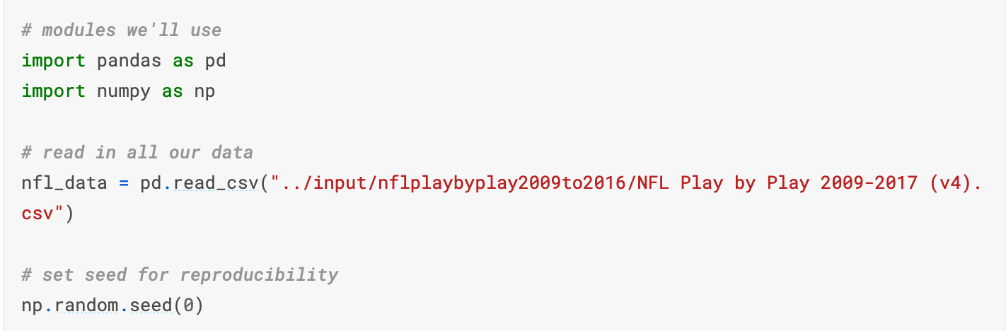
Handling Missing Values
https://www.kaggle.com/alexisbcook/handling-missing-values

Slide 38
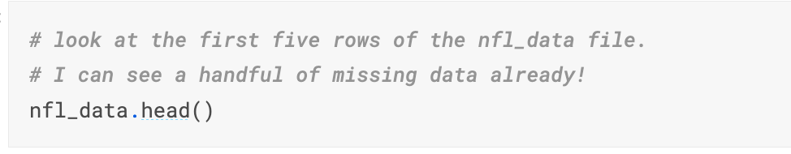
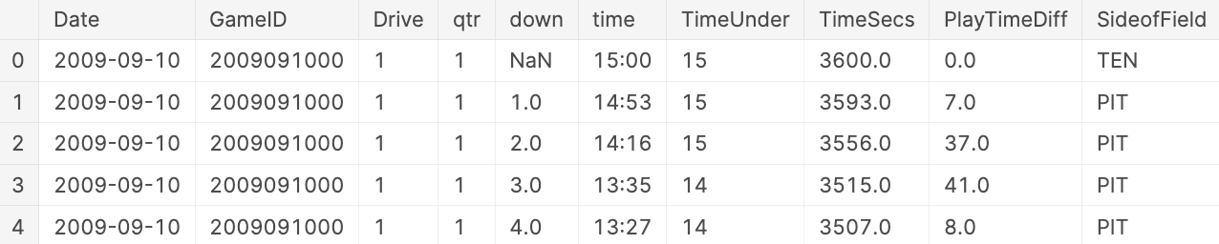
Handling Missing Values
https://www.kaggle.com/alexisbcook/handling-missing-values

Slide 39
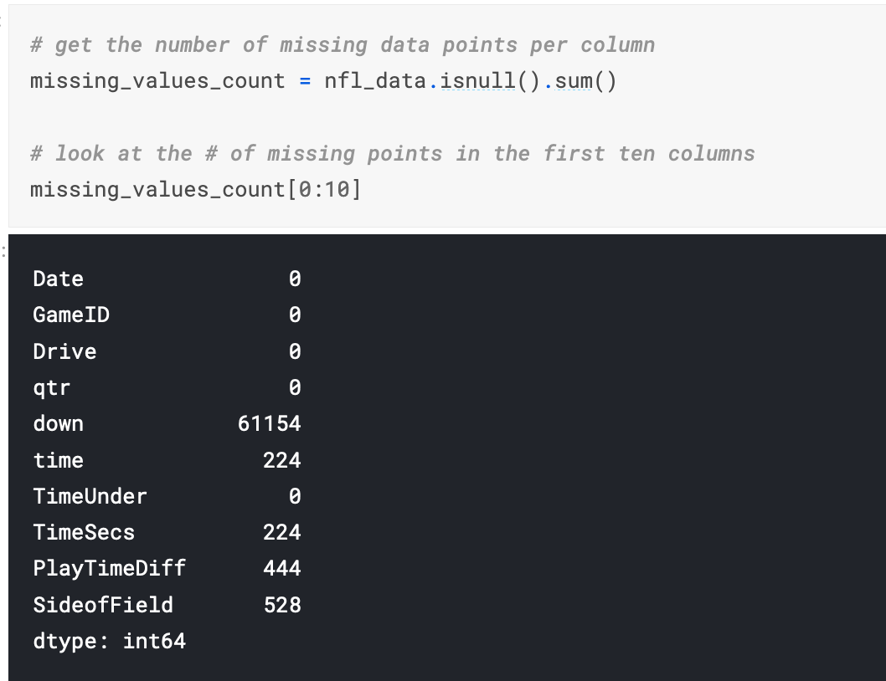
How many missing data points do we have?
https://www.kaggle.com/alexisbcook/handling-missing-values

Slide 40
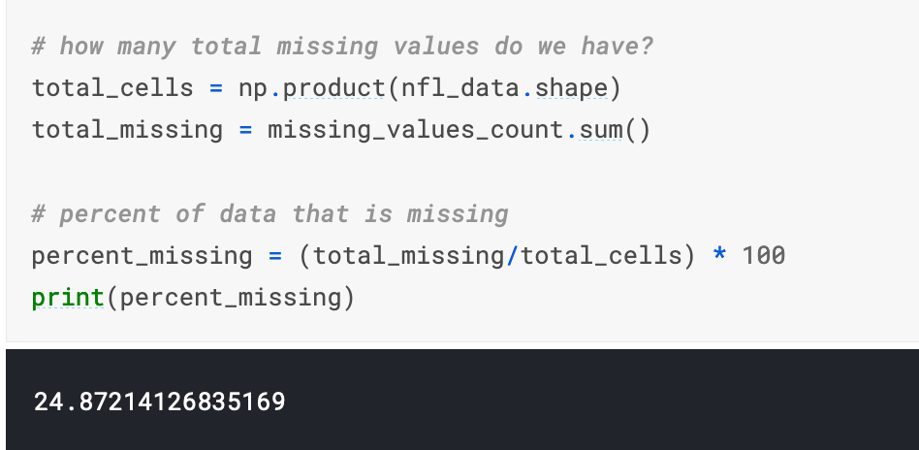
How many missing data points do we have?
https://www.kaggle.com/alexisbcook/handling-missing-values

Slide 41
Figure out why the data is missing
Is this value missing because it wasn't recorded or because it doesn't exist?
If a value is missing because it doesn't exist then it doesn't make sense to try and guess what it might be.
These values you probably do want to keep as NaN.
On the other hand, if a value is missing because it wasn't recorded, then you can try to guess what it might have been based on the other values in that column and row.
This is called imputation.
https://www.kaggle.com/alexisbcook/handling-missing-values

Slide 42
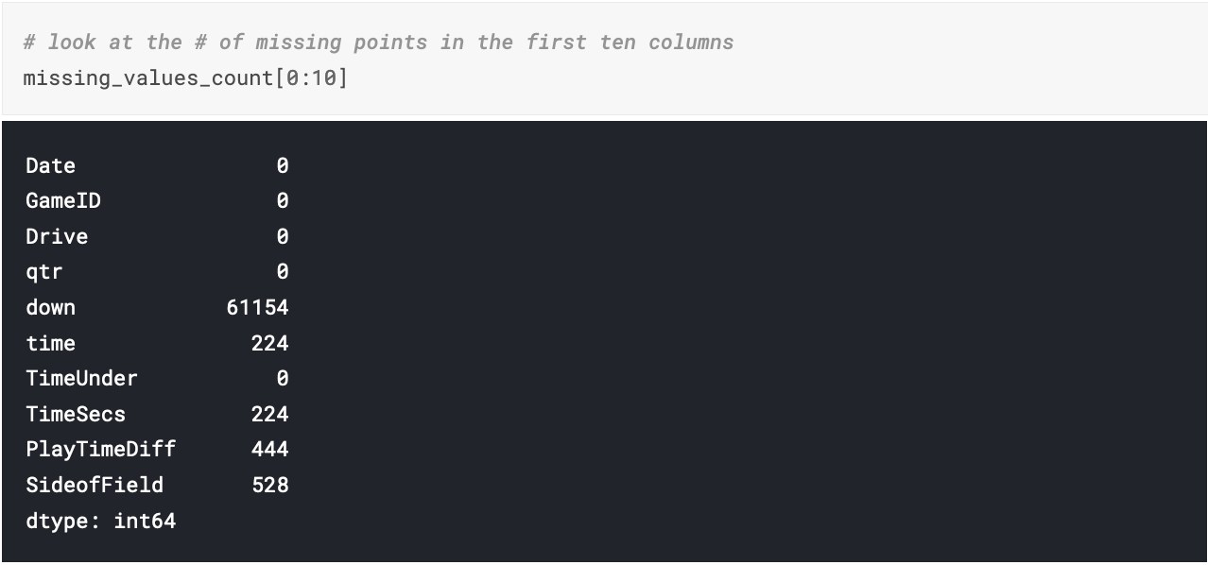
Figure out why the data is missing
https://www.kaggle.com/alexisbcook/handling-missing-values

Slide 43
Figure out why the data is missing
column "TimesSec" has a lot of missing values in it:
In this case, this column has information on the number of seconds left in the game when the play was made.
This means that these values are probably missing because they were not recorded, rather than because they don't exist.
So, it would make sense for us to try and guess what they should be rather than just leaving them as NA's.
https://www.kaggle.com/alexisbcook/handling-missing-values

Slide 44
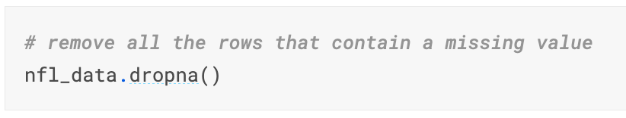
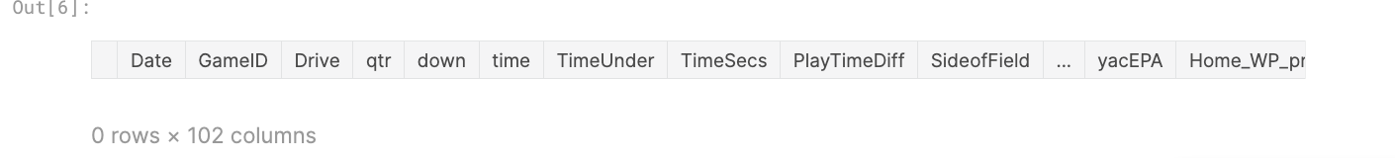
Drop Missing Values
One option you have is to just remove any rows or columns that contain missing values.
If you're in a hurry or don't have a reason to figure out why your values are missing, one option you have is to just remove any rows or columns that contain missing values.
https://www.kaggle.com/alexisbcook/handling-missing-values

Slide 45
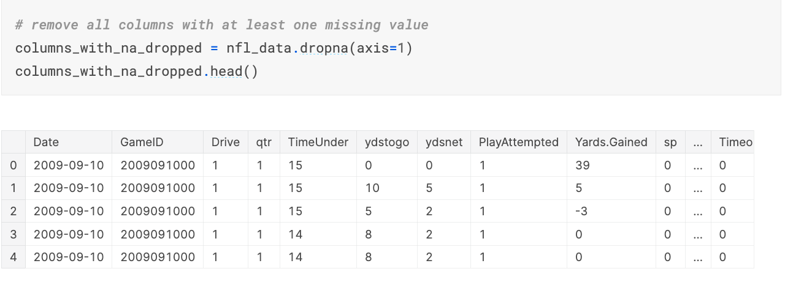
Drop Missing Values
We might have better luck removing all the columns that have at least one missing value instead.
https://www.kaggle.com/alexisbcook/handling-missing-values

Slide 46
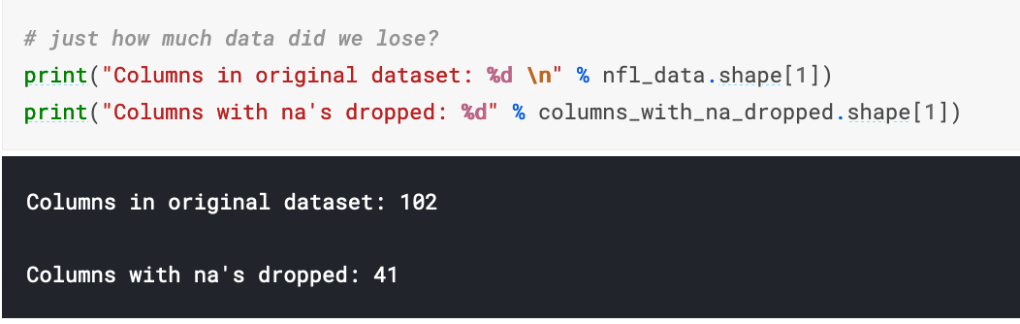
Drop Missing Values
https://www.kaggle.com/alexisbcook/handling-missing-values

Slide 47
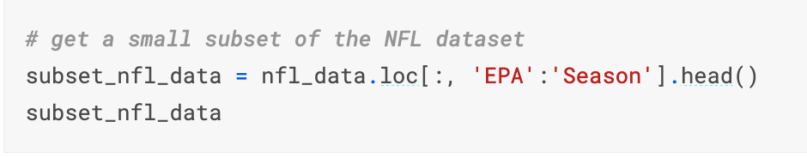
Filling in missing values automatically
Another option is to try and fill in the missing values.
https://www.kaggle.com/alexisbcook/handling-missing-values

Slide 48
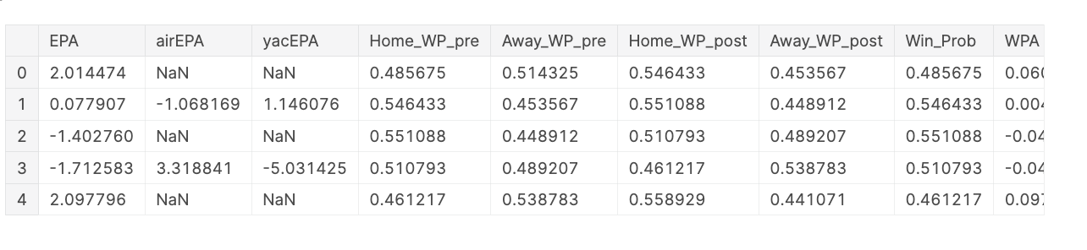
Filling in missing values automatically
https://www.kaggle.com/alexisbcook/handling-missing-values

Slide 49
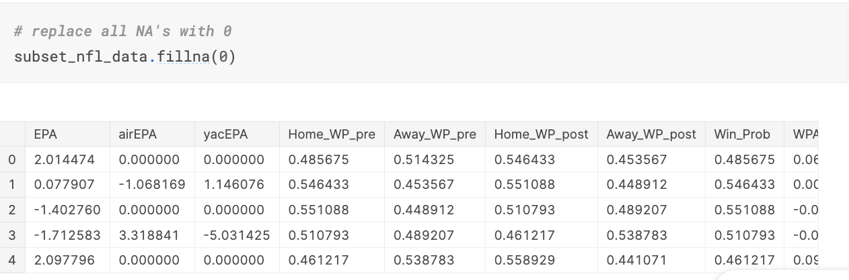
Filling in missing values automatically
https://www.kaggle.com/alexisbcook/handling-missing-values

Slide 50
Filling in missing values automatically
We could also be a bit more savvy and replace missing values with whatever value comes directly after it in the same column.
(This makes a lot of sense for datasets where the observations have some sort of logical order to them.)
Recap of Pandas' fillna
method='ffill': Ffill or forward-fill propagates the last observed non-null value forward until another non-null value is encountered.
2. method='bfill': Bfill or backward-fill propagates the first observed non-null value backward until another non-null value is met.
https://www.kaggle.com/alexisbcook/handling-missing-values

Slide 51
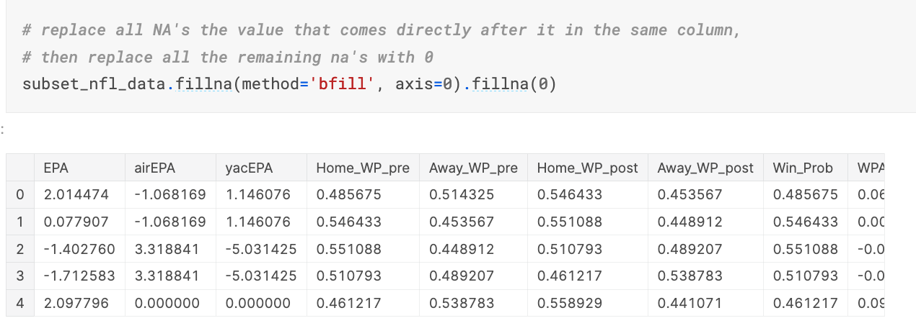
Filling in missing values automatically
https://www.kaggle.com/alexisbcook/handling-missing-values

Slide 52
Inconsistent Data Entry
https://www.kaggle.com/alexisbcook/inconsistent-data-entry

Slide 53
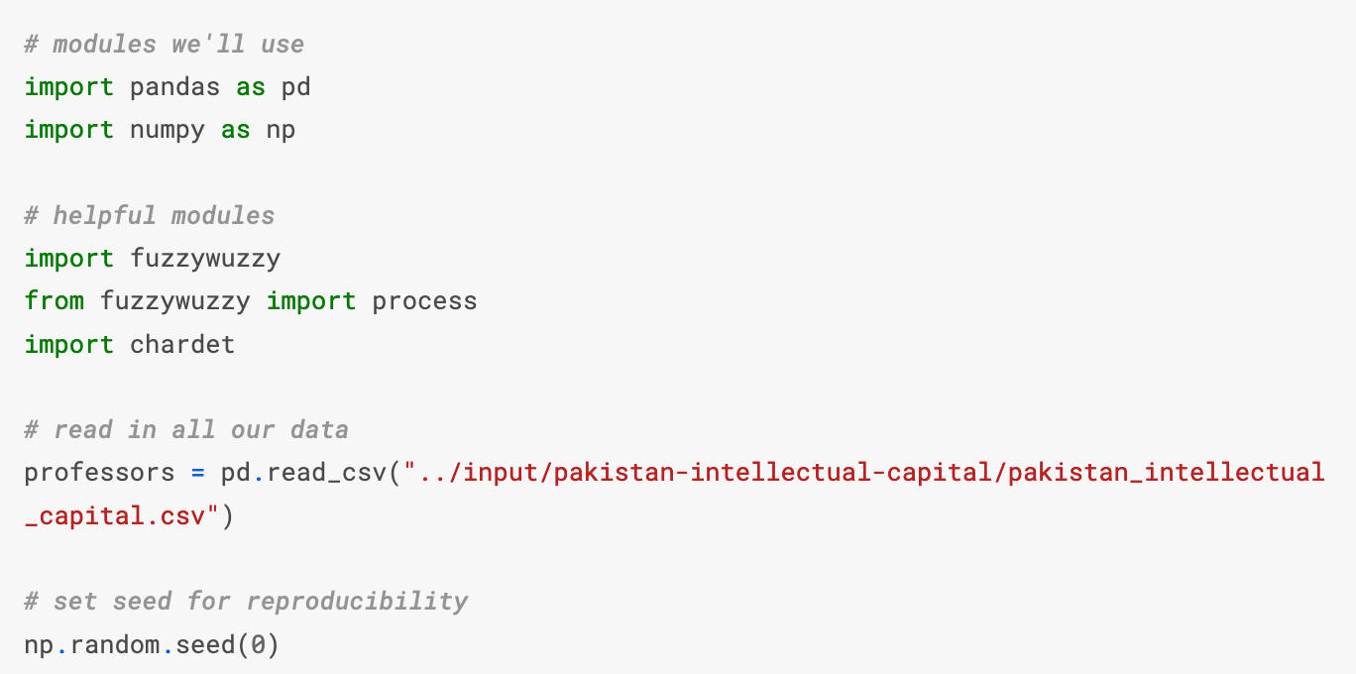
Inconsistent Data Entry
https://www.kaggle.com/alexisbcook/inconsistent-data-entry

Slide 54
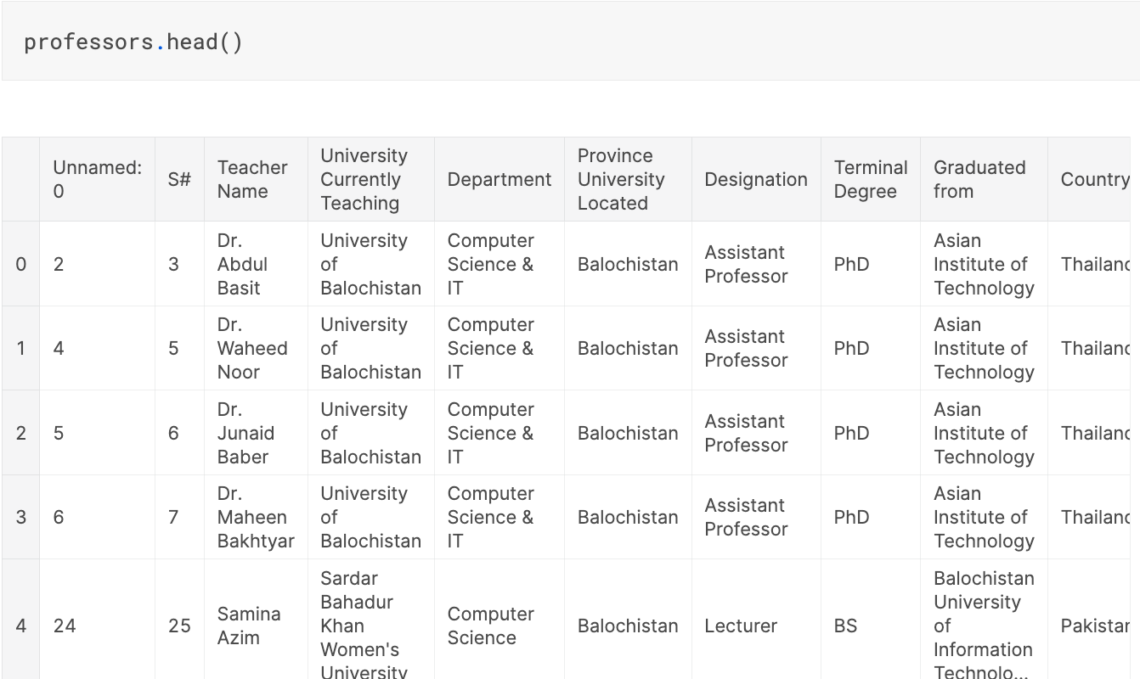
Inconsistent Data Entry
https://www.kaggle.com/alexisbcook/inconsistent-data-entry

Slide 55
Inconsistent Data Entry
Say we're interested in cleaning up the "Country" column to make sure there's no data entry inconsistencies in it.
We could go through and check each row by hand, of course, and hand-correct inconsistencies when we find them.
There's a more efficient way to do this, though!
https://www.kaggle.com/alexisbcook/inconsistent-data-entry

Slide 56
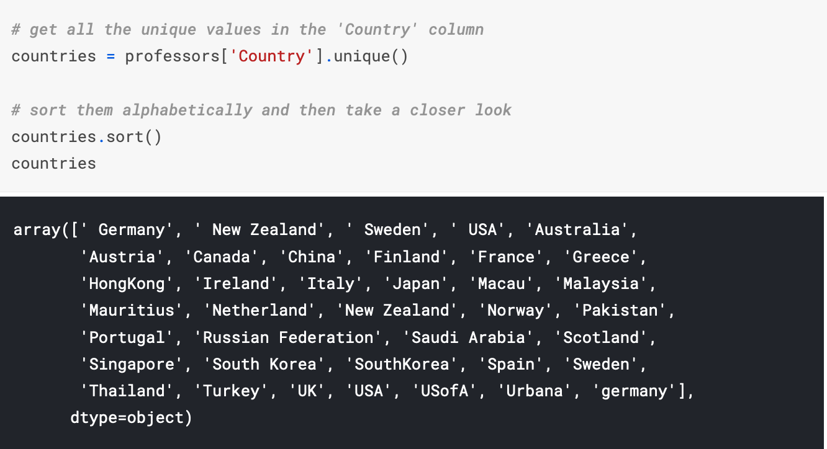
Inconsistent Data Entry
https://www.kaggle.com/alexisbcook/inconsistent-data-entry

Slide 57
Inconsistent Data Entry
Just looking at this, we can see some problems due to inconsistent data entry: ' Germany', and 'germany', for example, or ' New Zealand' and 'New Zealand’.
The first thing we can to do is make everything lower case and remove any white spaces at the beginning and end of cells.
https://www.kaggle.com/alexisbcook/inconsistent-data-entry

Slide 58
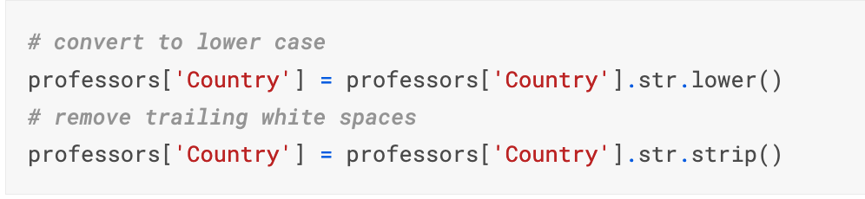
Inconsistent Data Entry
Inconsistencies in capitalizations and trailing white spaces are very common in text data and you can fix a good 80% of your text data entry inconsistencies by doing this.
https://www.kaggle.com/alexisbcook/inconsistent-data-entry

Slide 59
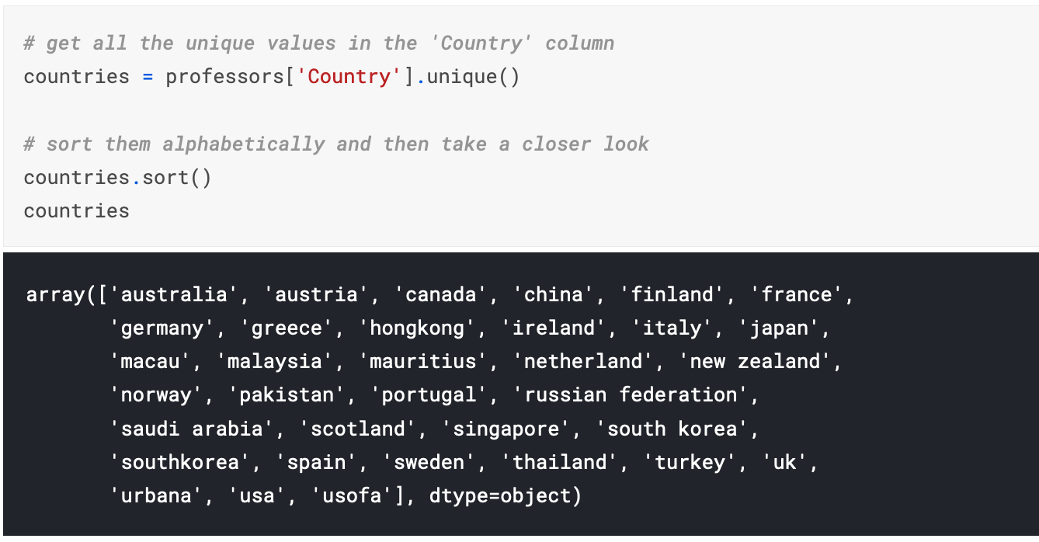
Inconsistent Data Entry
https://www.kaggle.com/alexisbcook/inconsistent-data-entry

Slide 60
Fuzzy Matching

Slide 61
Fuzzy Matching
Fuzzy matching:
The process of automatically finding text strings that are very similar to the target string.
In general, a string is considered "closer" to another one the fewer characters you'd need to change if you were transforming one string into another.
So "apple" and "snapple" are two changes away from each other (add "s" and "n") while "in" and "on" and one change away (rplace "i" with "o").
You won't always be able to rely on fuzzy matching 100%, but it will usually end up saving you at least a little time.

Slide 62
Fuzzy Matching
If you are using more than one dataset or unclean, unstandardized data, you might use fuzzy matching to find and combine duplicates.
Fuzzy matching allows you to determine if two items (usually strings) are “the same.”
Fuzzy matching can help us relate “My dog & I” and “me and mydog” as having similar meaning

Slide 63
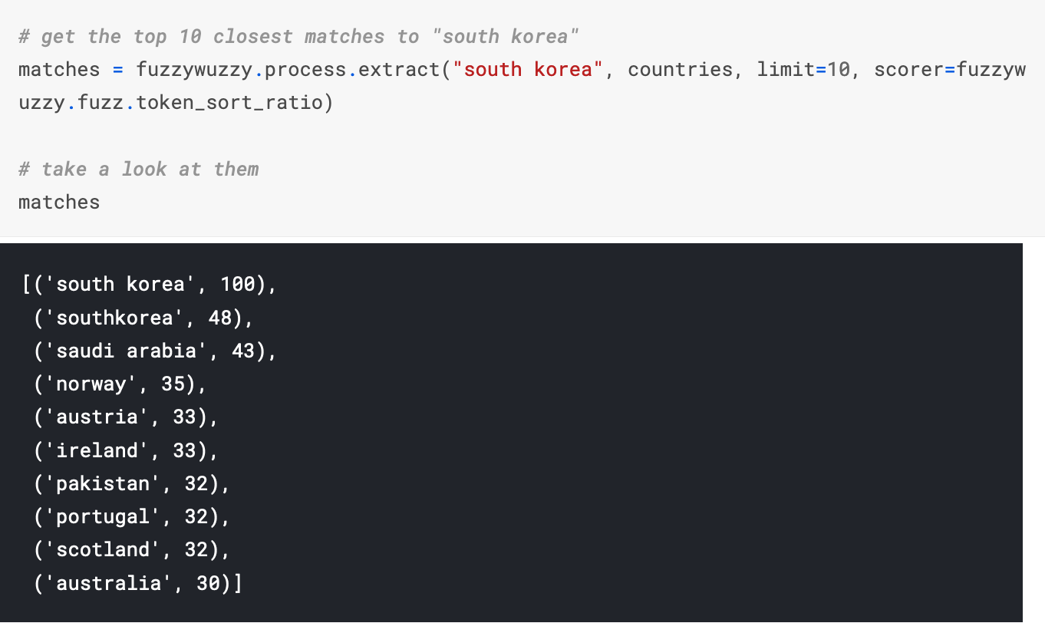
Fuzzy Matching
We can see that two of the items in the cities are very close to "south korea": "south korea" and "southkorea". Let's replace all rows in our "Country" column that have a ratio of > 47 with "south korea".

Slide 64
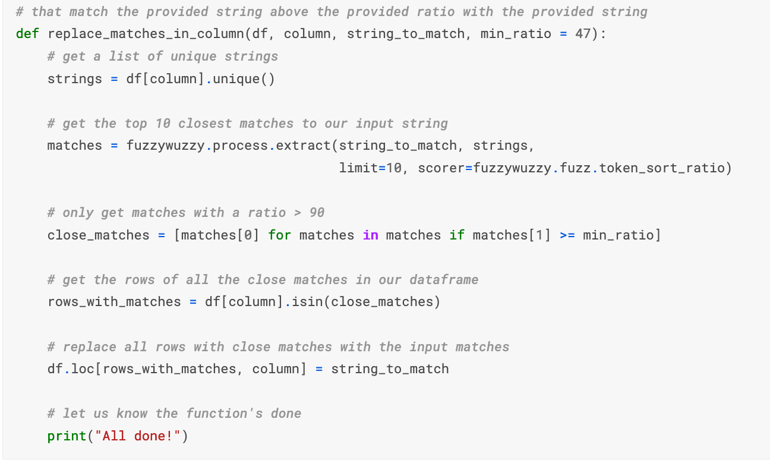
Fuzzy Matching

Slide 65
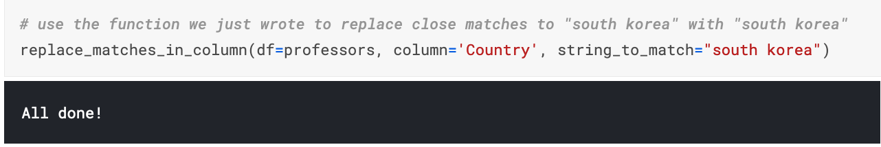
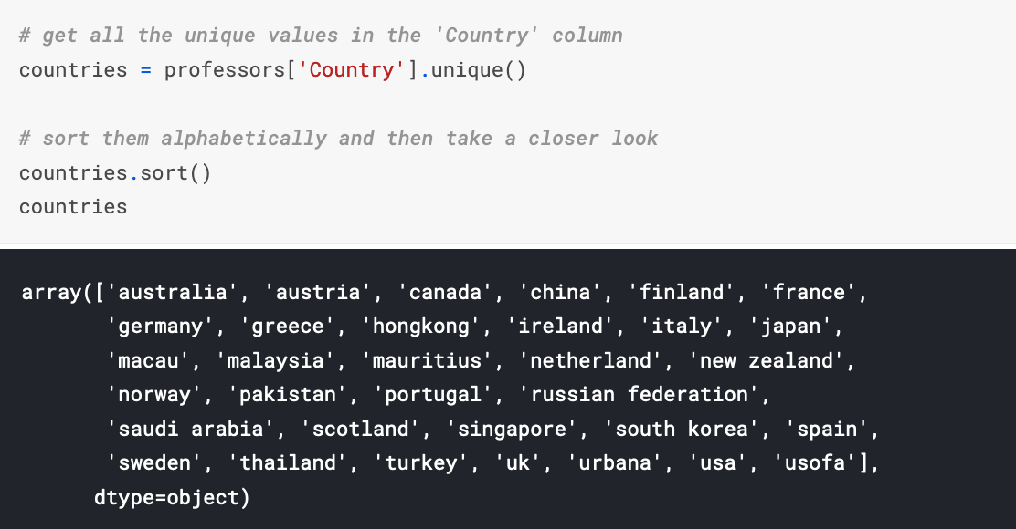
Fuzzy Matching

Slide 66
More Example of Fuzzy Matching

Slide 67
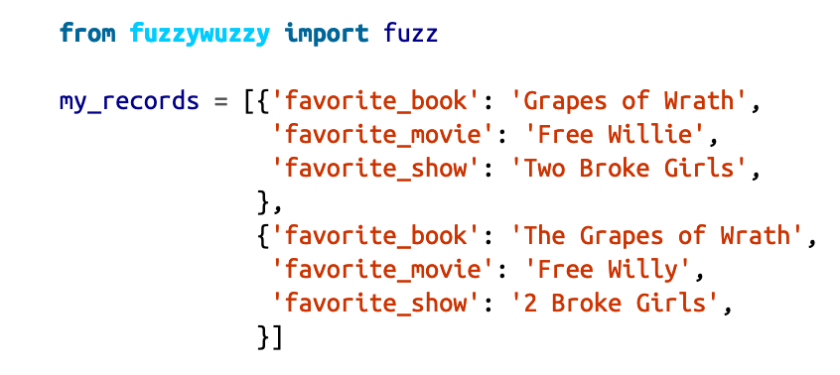
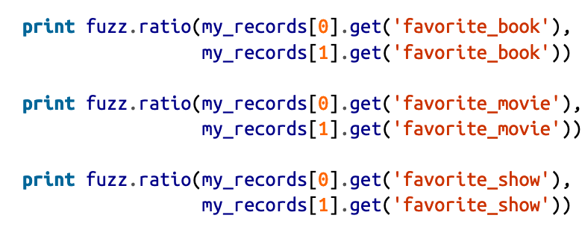
Fuzzy Matching
pip install fuzzywuzzy
fuzz module’s ratio function, which expects two strings to com‐pare. It returns the similarity of the sequencing of the strings (a value between 1and 100).

Slide 68
Fuzzy Matching
Here we use the fuzz module’s ratio function, which expects two strings to compare.
It returns the similarity of the sequencing of the strings (a value between 1 and 100).
Let’s try another FuzzyWuzzy method and see our results.

Slide 69
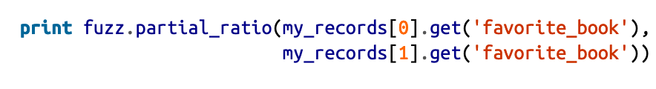
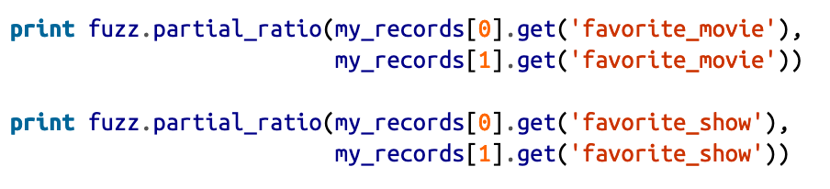
Fuzzy Matching
Here we call the fuzz module’s partial_ratio function, which expects two strings to compare.
It returns the similarity of the sequencing of the closest matching substrings (a value between 1 and 100).

Slide 70

Fuzzy Matching
Some other cool options of Fuzzy Matching

Slide 71
Fuzzy Matching
Here we call the fuzz module’s token_sort_ratio function, which allows us to match strings despite word order.
This is great for free-form survey data, where“I like dogs and cats” and “I like cats and dogs” mean the same thing.
Each string is first sorted and then compared, so if they contain the same words in a different order, they will match.

Slide 72

Fuzzy Matching
Here we use the fuzz module’s token_set_ratio function, which uses the same token approach but compares sets of the tokens to see intersection and difference.
The function attempts to find the best possible match of sorted tokens and returns the ratio of similarity for those tokens.

Slide 73
More Example of Fuzzy Matching
The fuzz.token functions have an important advantage over ratio and partial_ratio.
They tokenize the strings and preprocess them by turning them to lower case and getting rid of punctuation.
In the case of fuzz.token_sort_ratio(), the string tokens get sorted alphabetically and then joined together.
After that, a simple fuzz.ratio() is applied to obtain the similarity percentage.

Slide 74
More Example of Fuzzy Matching
Still, what happens if these two strings are of widely differing lengths?
Thats where fuzz.token_set_ratio() comes in.
Example in the next slide:

Slide 75

More Example of Fuzzy Matching

Slide 76
More Example of Fuzzy Matching
It's just string preprocessing under the hood.
In particular, fuzz.token_set_ratio() takes a more flexible approach than fuzz.token_sort_ratio().

Slide 77
More Example of Fuzzy Matching
Instead of just tokenizing the strings, sorting and then pasting the tokens back together, token_set_ratio performs a set operation that takes out the common tokens (the intersection) and then makes fuzz.ratio() pairwise comparisons between the following new strings:
s1 = Sorted_tokens_in_intersection
s2 = Sorted_tokens_in_intersection + sorted_rest_of_str1_tokens
s3 = Sorted_tokens_in_intersection + sorted_rest_of_str2_tokens
The logic behind these comparisons is that since Sorted_tokens_in_intersection is always the same, the score will tend to go up as these words make up a larger chunk of the original strings or the remaining tokens are closer to each other.

Slide 78

More Example of Fuzzy Matching
The fuzzywuzzy package has a module called process that allows you to calculate the string with the highest similarity out of a vector of strings.

Slide 79
Fuzzy Matching
pip install fuzzywuzzy
fuzz module’s ratio function, which expects two strings to com‐pare. It returns the similarity of the sequencing of the strings (a value between 1and 100).

Slide 80
Fuzzy Matching
Here we use the fuzz module’s ratio function, which expects two strings to compare.
It returns the similarity of the sequencing of the strings (a value between 1 and 100).
Let’s try another FuzzyWuzzy method and see our results.

Slide 81
Fuzzy Matching
Here we call the fuzz module’s partial_ratio function, which expects two strings to compare.
It returns the similarity of the sequencing of the closest matching substrings (a value between 1 and 100).

Slide 82
Fuzzy Matching
Some other cool options of Fuzzy Matching

Slide 83
Fuzzy Matching
Here we call the fuzz module’s token_sort_ratio function, which allows us to match strings despite word order.
This is great for free-form survey data, where“I like dogs and cats” and “I like cats and dogs” mean the same thing.
Each string is first sorted and then compared, so if they contain the same words in a different order, they will match.

Slide 84
Fuzzy Matching
Here we use the fuzz module’s token_set_ratio function, which uses the same token approach but compares sets of the tokens to see intersection and difference.
The function attempts to find the best possible match of sorted tokens and returns the ratio of similarity for those tokens.

Slide 85
Let’s Try the Code!

Slide 86
Scaling and Normalization
https://www.kaggle.com/alexisbcook/scaling-and-normalization

Slide 87
Scaling and Normalizing
Depending on your data and the type of research you are conducting, scaling and normalizing your dataset might mean calculating new values using the values you currently have.
or it might mean applying scaling or normalizations across a particular column or value

Slide 88
Scaling and Normalizing
Normalization, from a statistical view, often has to do with calculating new values from a dataset to standardize the data on a particular scale.
For example, you might need to normalize scores for a test to scale so you can accurately view the distribution.
You might also need to normalize data so you can accurately see percentiles, or percentiles across different groups

Slide 89
Why you should do this?
Why do we need to scale the variables in our dataset?
Some machine learning algorithms are sensitive to feature scaling while others are virtually invariant to it.
Machine learning algorithms like linear regression, logistic regression, neural network, etc. that use gradient descent as an optimization technique require data to be scaled.
Having features on a similar scale can help the gradient descent converge more quickly towards the minima.

Slide 90
Why you should do this?
Distance algorithms like KNN, K-means, and SVM are most affected by the range of features.
This is because behind the scenes they are using distances between data points to determine their similarity.
Therefore, we scale our data before employing a distance based algorithm so that all the features contribute equally to the result.

Slide 91
Why you should do this?
Tree-based algorithms, on the other hand, are fairly insensitive to the scale of the features.
Think about it, a decision tree is only splitting a node based on a single feature. The decision tree splits a node on a feature that increases the homogeneity of the node.
This split on a feature is not influenced by other features.

Slide 92
Scaling and Normalization
Scaling vs. Normalization: What's the difference?
One of the reasons that it's easy to get confused between scaling and normalization is because the terms are sometimes used interchangeably and, to make it even more confusing, they are very similar!
In both cases, you're transforming the values of numeric variables so that the transformed data points have specific helpful properties. The difference is that:
in scaling, you're changing the range of your data, while
in normalization, you're changing the shape of the distribution of your data.

Slide 93
Scaling
This means that you're transforming your data so that it fits within a specific scale, like 0-100 or 0-1.
You want to scale data when you're using methods based on measures of how far apart data points are, like support vector machines (SVM) or k-nearest neighbors (KNN).
With these algorithms, a change of "1" in any numeric feature is given the same importance.

Slide 94
Scaling
For example, you might be looking at the prices of some products in both Yen and US Dollars.
One US Dollar is worth about 100 Yen, but if you don't scale your prices, methods like SVM or KNN will consider a difference in price of 1 Yen as important as a difference of 1 US Dollar!
This clearly doesn't fit with our intuitions of the world. With currency, you can convert between currencies.
But what about if you're looking at something like height and weight? It's not entirely clear how many pounds should equal one inch (or how many kilograms should equal one meter).

Slide 95

Min-Max Scaling
Here’s the formula for Min-Max scaling:

Slide 96

Scaling

Slide 97

Scaling

Slide 98

Scaling

Slide 99

Scaling
http://rasbt.github.io/mlxtend/user_guide/preprocessing/minmax_scaling/

Slide 100

Scaling
http://rasbt.github.io/mlxtend/user_guide/preprocessing/minmax_scaling/

Slide 101
Scaling
You can also look at:
https://scikit-learn.org/stable/modules/generated/sklearn.preprocessing.MinMaxScaler.html
Transform features by scaling each feature to a given range.
This estimator scales and translates each feature individually such that it is in the given range on the training set, e.g. between zero and one.

Slide 102

Scaling

Slide 103
Normalization
Scaling just changes the range of your data.
Normalization is a more radical transformation. The point of normalization is to change your observations so that they can be described as a normal distribution.
Normal distribution: Also known as the "bell curve", this is a specific statistical distribution where a roughly equal observations fall above and below the mean, the mean and the median are the same, and there are more observations closer to the mean. The normal distribution is also known as the Gaussian distribution.

Slide 104
Normalization
In general, you'll normalize your data if you're going to be using a machine learning or statistics technique that assumes your data is normally distributed.
Some examples of these include linear discriminant analysis (LDA) and Gaussian naive Bayes.

Slide 105

Normalizing
This means that the mean of the attribute becomes zero and the resultant
distribution has a unit standard deviation.
Here’s the formula for normalization:

Slide 106

Normalization

Slide 107

Normalization
Notice that the shape of our data has changed.
Before normalizing it was almost L-shaped. But after normalizing it looks more like the outline of a bell (hence "bell curve").

Slide 108

Box-cox transform of train and test data
https://www.kaggle.com/rtatman/boxcox-transform-on-train-test-data

Slide 109

Box-cox transform of train and test data
https://www.kaggle.com/rtatman/boxcox-transform-on-train-test-data

Slide 110
Let’s Try the Code!

Slide 111
Scaling & Normalization: Another Example

Slide 112
Scaling & Normalization: Another Example
Kickstarter Project Dataset

Slide 113

Scaling & Normalization: Another Example

Slide 114

Scaling & Normalization: Another Example

Slide 115

Scaling & Normalization: Another Example
Let's start by scaling the goals of each campaign, which is how much money they were asking for.

Slide 116

Scaling & Normalization: Another Example

Slide 117

Scaling & Normalization: Another Example

Slide 118

Scaling & Normalization: Another Example

Slide 119
Let’s Try The Code!

